Slide 1
Module 3 : Internet Security
Internet Communication Engineering

Slide 2
NETWORK LAYER SECURITY
We need security at the network layer.
IP Security (IPSec) is a collection of protocols designed by the Internet Engineering Task Force (IETF) to provide security for a packet at the network level.
IPSec helps create authenticated and confidential packets for the IP layer.

Slide 3
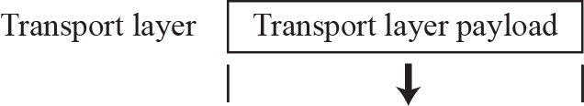
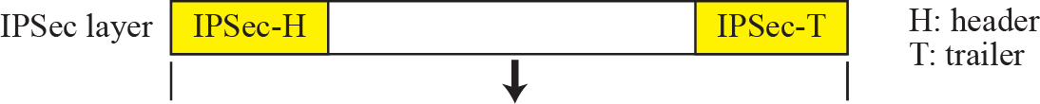
Two Modes :
IPSec operates in one of two different modes :
Transport Mode
Tunnel Mode
Transport Mode:
In this, IPSec protects what is delivered from the transport layer to the network layer.
It protects the payload to be encapsulated in the network layer.It is finite and terminates when the service is complete.

Slide 4
IPSec in transport mode does not protect the IP header;
it only protects the information coming from the transport layer.

Slide 5
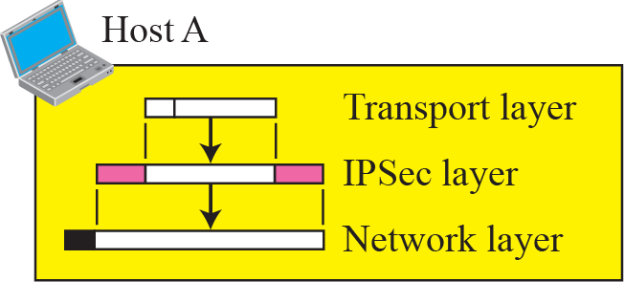
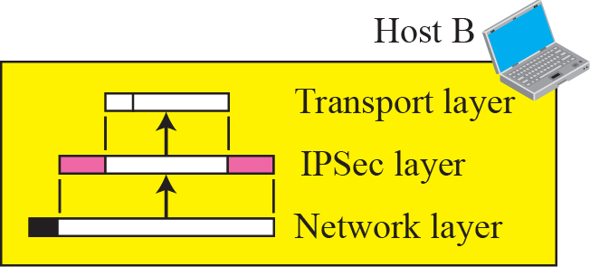
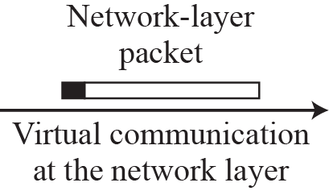
Transport mode in action
Transport mode is normally used when we need host-to-host (end-to-end) protection of data.
Sending host uses IPSec to authenticate and/or encrypt the payload delivered from the transport layer.
Receiving host uses IPSec to check authentication and/or decrypt IP packet and deliver it to transport layer.

Slide 6
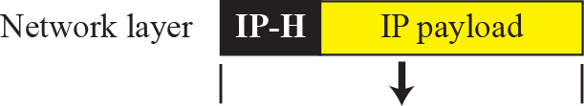
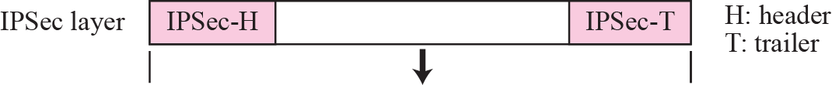
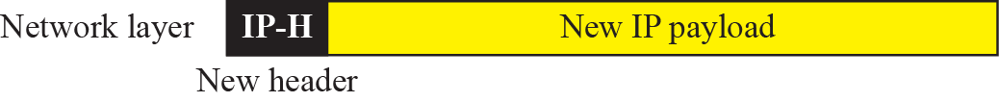
Tunnel Mode
In this mode, IPSec protects the entire IP packet.
It takes an IP packet including header, applies IPSec security methods to the entire packet and then adds new IP header.

Slide 7
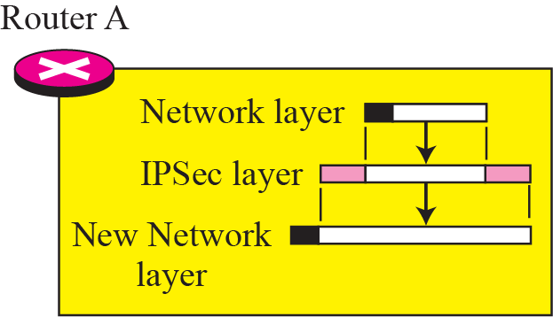
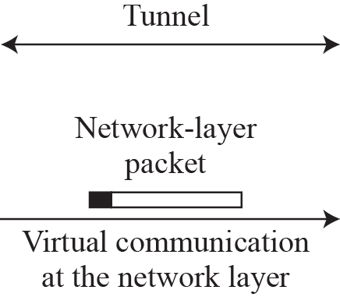
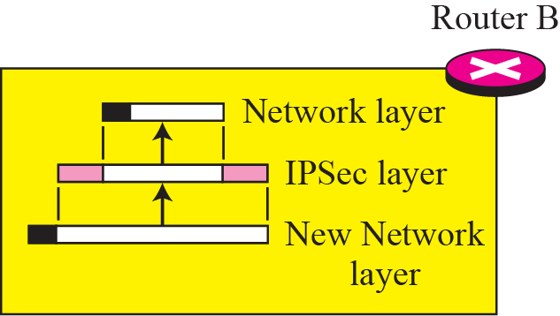
Tunnel mode in action
This mode is normally used between two routers.
The entire original packet is protected from intrusion between the sender and the receiver as if the whole packet goes through an imaginary tunnel.
IPSec in tunnel mode protects the original IP header.

Slide 8
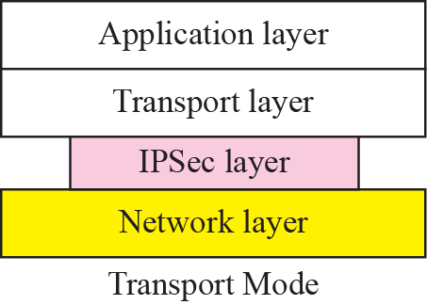
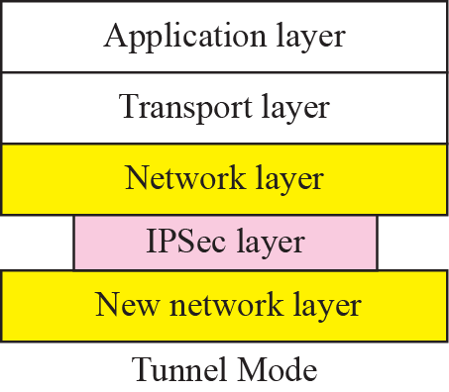
Transport mode versus tunnel mode
In transport mode, the IPSec layer comes between the transport layer and the network layer.
In tunnel mode, the flow is from the network layer to the IPSec layer and then back to the network layer again.

Slide 9
Security Protocols
IPSec defines two protocols :
Authentication Header (AH) Protocol &
Encapsulating Security Payload (ESP) Protocol
These protocols are used to provide authentication and/or encryption for packets at the IP level.

Slide 10
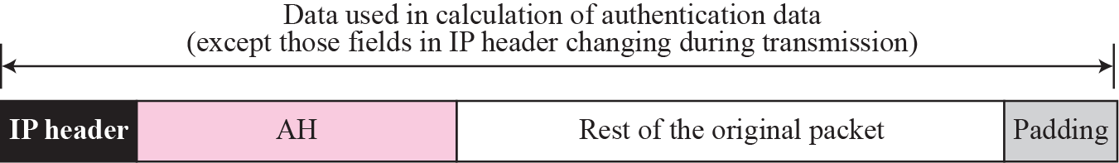
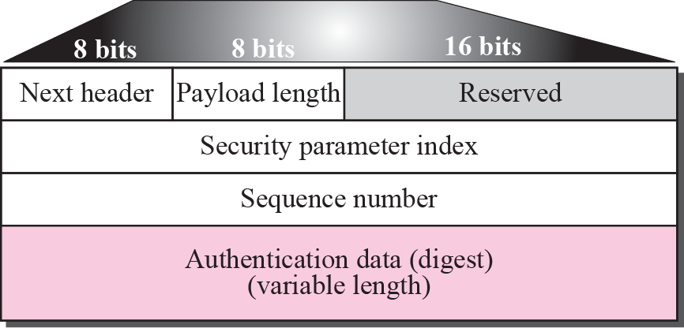
Authentication Header (AH) Protocol

Slide 11
AH Protocol
This protocol is designed to authenticate the source host and to ensure the integrity of the payload carried in the IP packet.
It uses hash function and symmetric(secret) key to create message digest.
Digest is inserted in authentication header.
AH is then placed in the appropriate location based on the mode.

Slide 12
Contd…
The addition of authentication header follows following steps :
Authentication header is added to the payload with authentication data field set to 0.
Padding may be added to make the total length even for a particular hashing algorithm.
Hashing is based on the total packet.
The authentication data are inserted in the authentication header.
The IP header is added after changing the value of the protocol field to 51.

Slide 13
Contd…
Header fields are explained below :
Next Header : Defines type of payload carried by IP datagram.
Payload Length : Defines the length of the authentication header in 4 byte multiples.
Security parameter index : This field plays role of virtual circuit identifier.
Sequence Number : Provides ordering information for a sequence of datagrams.
Authentication Data : This field is the result of applying a hash function to the entire IP datagram except for the fields that are changed during transit(ex. Time to live).

Slide 14
The AH protocol provides source authentication and data integrity, but not privacy.

Slide 15
Encapsulating Security Payload (ESP)
ESP provides source authentication, integrity and confidentiality
ESP adds a header and trailer.
ESP’s authentication data are added at the end of the packet which makes its calculation easier.

Slide 16
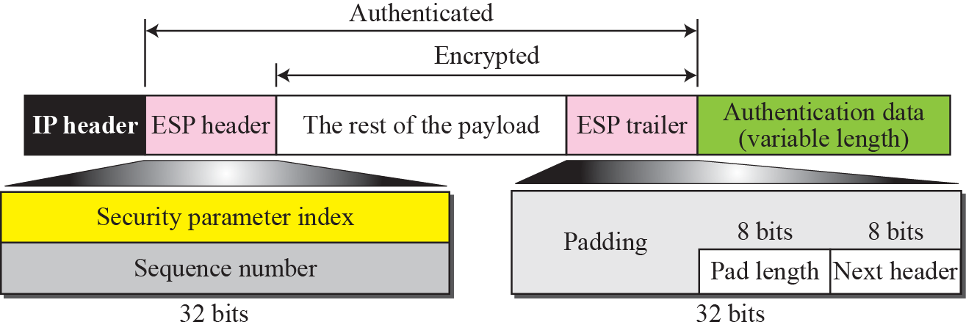
Contd…

Slide 17
ESP Procedure
ESP procedure follows following steps :
1. An ESP trailer is added to the payload.
2. The payload and the trailer are encrypted.
3. The ESP header is added.
4. ESP header, payload and ESP trailer are used to create the authentication data.
5. The authentication data are added to the end of the ESP trailer.

Slide 18
ESP Procedure
6. The IP header is added after changing the protocol value to 50.
The fields for header and trailer are :
-Security Parameter Index
-Sequence Number
-Padding
-Pad Length
-Next Header
-Authentication Data

Slide 19
Services provided by IPSec

Slide 20
Security Association
Security Association is a very important aspect of IPSec.
IPSec requires a logical relationship called a Security Association (SA) between two hosts.

Slide 21
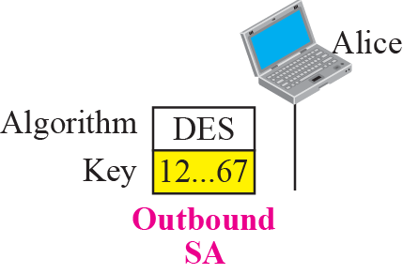
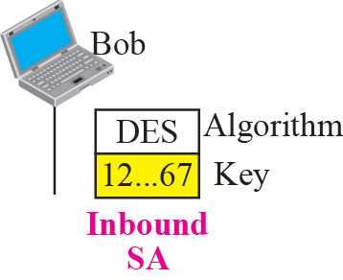
Idea of Security Association
Security Association is a contract between two parties ; it creates a secure channel between them.
Let us assume that Alice needs to unidirectionally communicate with Bob.
If both are interested only in the confidentiality aspect of security,they can create a shared secret key between themselves.
Two SA between Alice and Bob,one outbound SA and one inbound SA

Slide 22
Each of tem store key and Encryption/decryption algorithm
Security association can be more involved if two parties need message integrity and authentication.So it require other parameters and algorithm.so it becomes more complex.

Slide 23
Security Association Database (SAD)
A security association becomes more complex If Alice wants to send messages to many people and Bob needs to receive messages from many people .
In addition, each site needs to have both inbound and outbound SAs to allow bidirectional communication.
Meaning is, we need a set of SAs that can be collected into a database.
This database is called Security Association Database (SAD).It is a two dimensional table.
Each row define single SA.

Slide 24
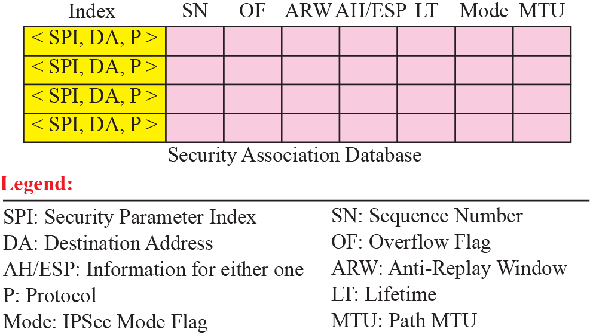
SAD

Slide 25
When a host need to send a packet that must carry IPSec header,host need to find corresponding entry in the outbound SAD to find the information for applying security to the packet.
When host receives a packet that carries IPSec header ,the host need to find corresponding entry in inbound SA D to find the information for checking the security of packet.
Each entry in inbound SAD is selected using triple index:security parameter index,destination address and protocol(AH or ESP)

Slide 26
Contd…
Security Policy :
Another important aspect of IPSec is Security Policy (SP) which defines the type of security applied to a packet when it is to be sent or when it has arrived. - Before using SAD , a host must determine the predefined policy for the packet.

Slide 27
Contd…
Security Policy Database:
Each host that is using the IPSec protocol needs to keep a Security Policy Database (SPD). - Also, there is a need for an inbound SPD and an outbound SPD.
Each entry in SPD can be accessed using six index: Source address,destination address, name,protocol,source port and destination port.

Slide 28
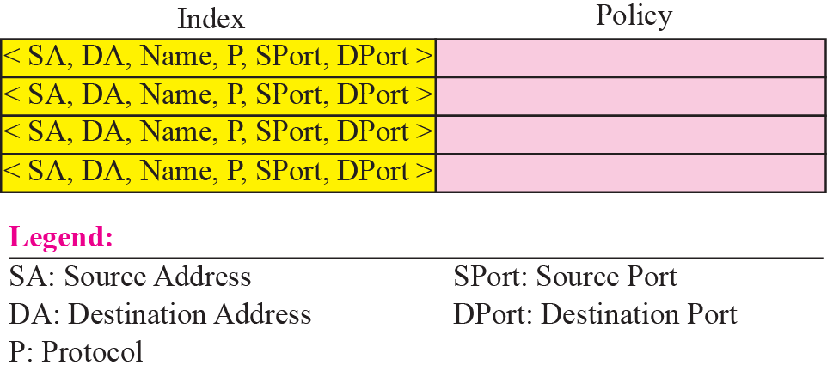
SPD
Name usually defines DNS entity

Slide 29
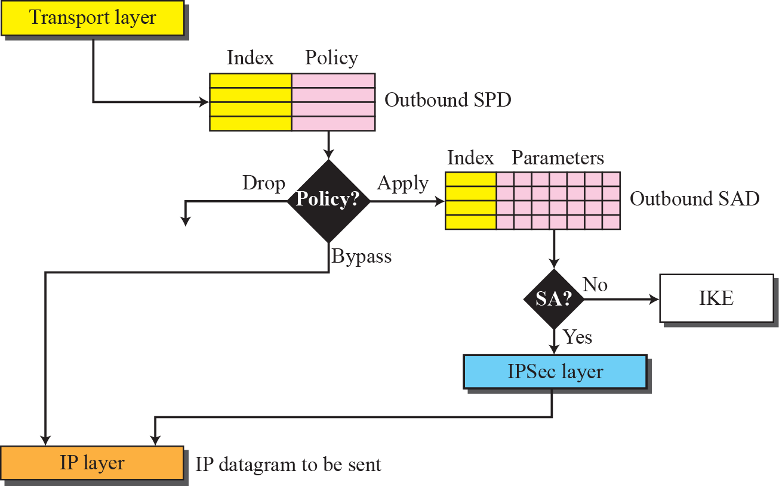
Outbound SPD
When a packet is to be sent out, the outbound SPD is consulted.
Fig shows the processing of a packet by a sender.
IKE:Internet Key Exchange

Slide 30
‘The input to outbound SPD is six parameters.
Out put is one of three cases
1. Drop(packet cannot be sent
2. bypass(bypassing security header).
3.appy(apply security according to SAD ,if no create one)

Slide 31
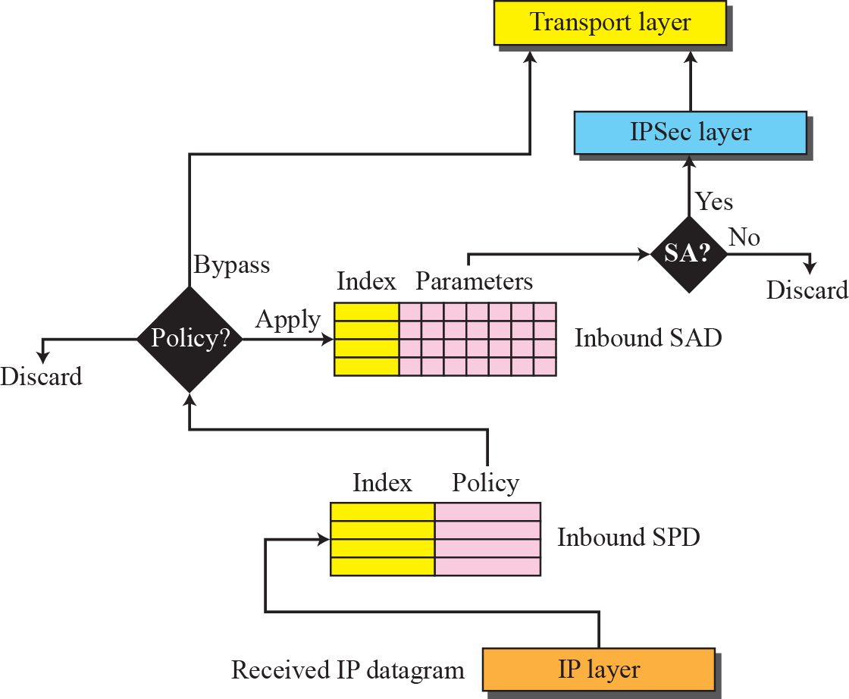
Inbound SPD
When a packet arrives, the inbound SPD is consulted.
Fig shows the processing of a packet by a receiver.

Slide 32
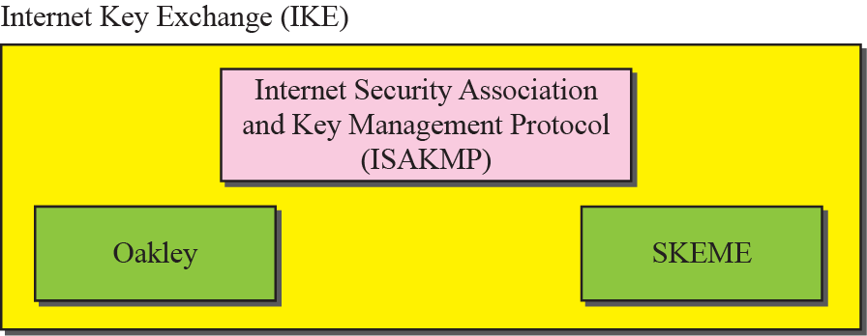
Internet Key Exchange (IKE)
IKE is a protocol designed to create both inbound and outbound Security Associations
If there is no SA, IKE is called to establish one.
IKE is a complex protocol based on three other protocols

Slide 33
Virtual Private Network (VPN)
One of the applications of IPSec is in virtual private networks.
VPN is a technology that use global Internet for both intra and inter organization communication.
VPN is a network that is private but virtual.
VPN technology uses ESP protocol of IPSec.
It guarantees privacy in organization.

Slide 34
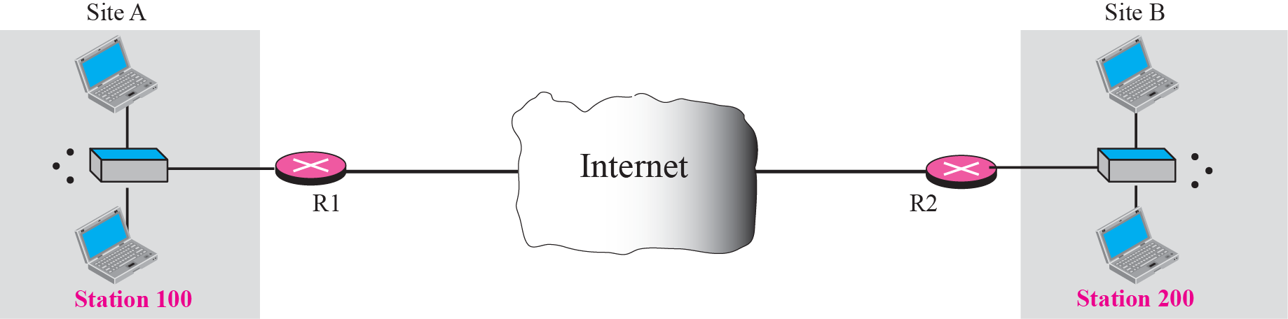
Virtual Private Network

Slide 35
Transport Layer Security
Two protocols are dominant today for providing security at the transport layer: the Secure Sockets Layer (SSL) protocol and the Transport Layer Security (TLS) protocol. Fig shows the position of SSL and TLS in the Internet model.
One of the goals of these protocols is to provide server and client authentication, data confidentiality and data integrity.

Slide 36
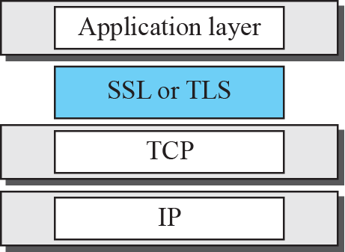
Location of SSL and TSL in the Internet mode

Slide 37
SSL Architecture
SSL is designed to provide security and compression services to data generated from the application layer.
SSL can receive data from any application layer protocol but usually the protocol is HTTP.
The data received from the application is compressed(optional), signed and encrypted.
The data is then passed to a reliable transport layer protocol such as TCP.

Slide 38
SSL Services
SSL provides several services on data received from application layer:
Fragmentation : First, SSL divides the data into blocks of 2^14 bytes or less.
Compression : Each fragment of data is compressed using one of the lossless compression methods negotiated between the client and server.This service is optional.
Message Integrity : To preserve the integrity of data, SSL uses a keyed hash function to create a MAC.
Confidentiality : To provide confidentiality, the original data and the MAC are encrypted using symmetric key cryptography.
Framing : A header is added to the encrypted payload. The payload is then passed to a reliable transport layer protocol.

Slide 39
Key Exchange Algorithms
To exchange an authenticated and confidential message, the client and the server each need a set of cryptographic secrets.
However, to create these secrets, one pre-master secret must be established between the two parties.
SSL defines several key exchange methods to establish this pre-master secret.

Slide 40
Key Exchange Algorithms
Encryption/Decryption Algorithms : Client and server also need to agree to a set of encryption and decryption algorithms.
Hash Algorithms : SSL uses hash algorithms to provide message integrity (message authentication).
Cipher Suite : The combination of key exchange, hash and encryption algorithms defines a cipher suite for each SSL session.
Compression Algorithms : Compression is optional in SSL. No specific compression algorithm is defined.There fore a system can use whatever compression algorithm it desires.

Slide 41
Cryptographic Parameter Generation
To achieve message integrity and confidentiality, SSL needs six cryptographic secrets, four keys and two IVs (Initialization vectors).
The client (Server also) needs one key for message authentication, one key for encryption and one IV as original block in calculation.The server needs the same.
SSL requires that the keys for one direction be different from those for the other direction.

Slide 42
Cryptographic Parameter Generation
The parameters are generated using the following procedure :
The client and server exchange two random numbers ; one is created by the client and the other by the server.
The client and server exchange one pre-master secret using one of the predefined key-exchange algorithms.
A 48-byte master secret is created from the pre-master secret by applying two hash functions (SHA-1 and MD5).
The master secret is used to create variable length key material by applying the same set of hash functions and prepending with different constants.
Six different secrets are extracted from the key material.

Slide 43
Calculation of maser key from pre-master secret

Slide 44
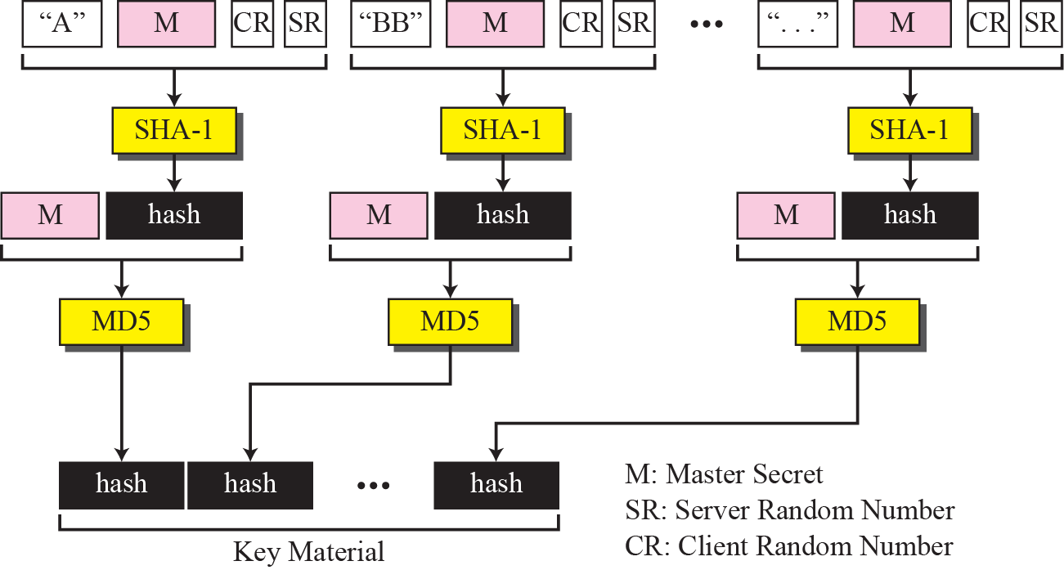
Calculation of the key materials from master secret

Slide 45
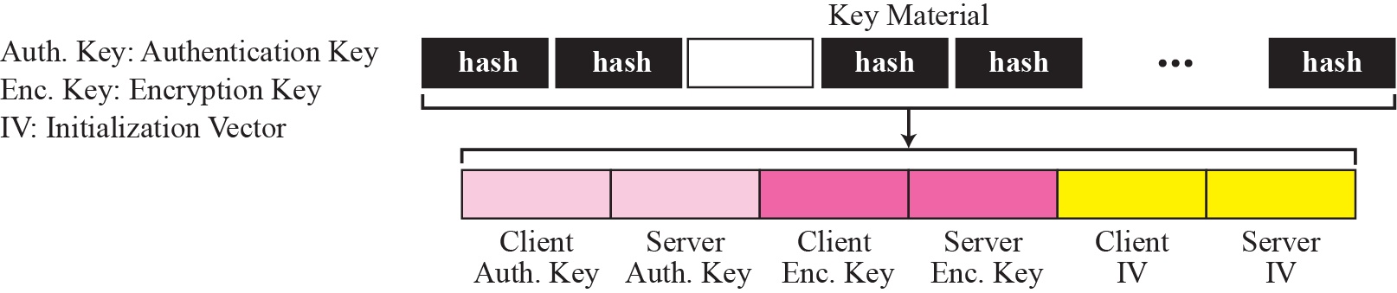
Extraction of cryptographic secrets from key materials

Slide 46
Sessions and Connections
SSL differentiates connection from session.
Session is an association between client and server.After session is established, the two parties have common information such as session identifier, compression method, cipher suite and a master secret that is used to create keys for message authentication encryption.
For two entities to exchange data, the establishment of session is necessary but not sufficient, they need to create connection between themselves.
Session can consist of many connections. A connection between two parties can be terminated and reestablished within the same session.

Slide 47
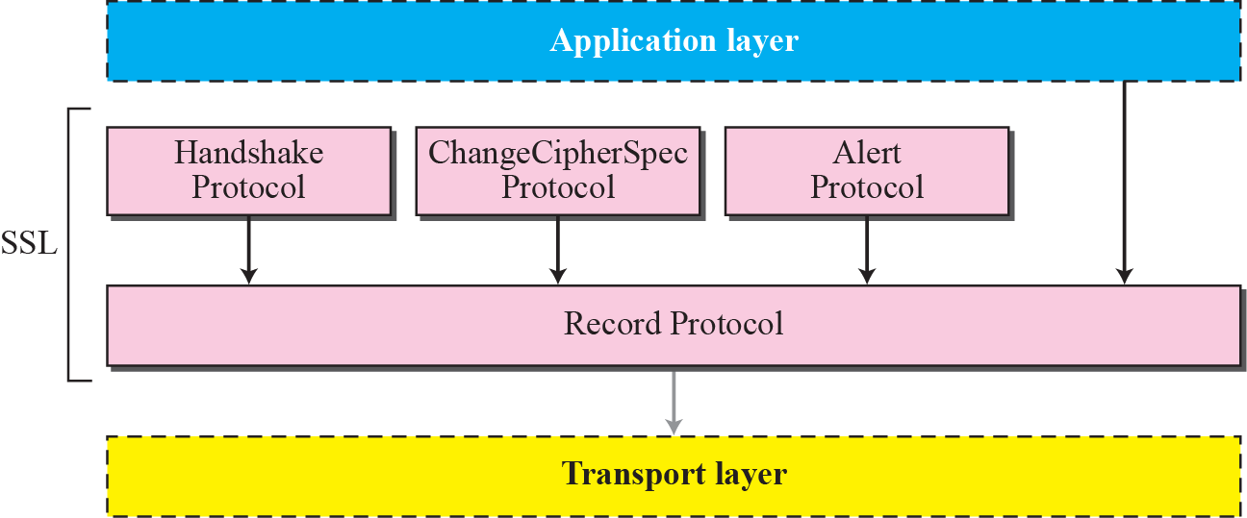
SSL Protocols
SSL accomplished its task using four protocol.

Slide 48
SSL Protocols
SSL defines four protocols in two layers to accomplish its tasks.
Record Protocol: It is the carrier.
It carries messages from three other protocols as well as the data coming from application layer.
Messages from record protocol are payloads to the transport layer normally TCP.

Slide 49
SSL Protocols
Handshake Protocol: It provides the security parameters for the record protocol.
It establishes a cipher set and provides keys and security parameters.
It also authenticates the server to the client and the client to the server if needed.

Slide 50
SSL Protocols
ChangeCipherSpec Protocol: It is used for signaling the readiness of cryptographic secrets.
Alert Protocol: It is used to report abnormal conditions.

Slide 51
Handshake Protocol
It uses messages to negotiate the cipher suit,to authenticate the server to the client and client to the server if needed, and to exchange information for building cryptographic secrets.

Slide 52
Handshake Protocol
Handshaking is done in four phases.
Phase I:Establishing security capability:
In this phase, the client and server announce their security capabilities and choose those that are convenient for both.
A session ID is established and the cipher suite is chosen.
The parties agree upon a particular compression method.
Finally two random numbers are selected, one by the client and one by the server to be used for creating a master secret .

Slide 53
After Phase I, the client and server know the version of SSL, the cryptographic algorithms, the compression method, and the two random numbers for key generation.

Slide 54
Handshake Protocol
Phase II:Server key exchange and authentication: In this phase, the server authenticates itself if needed.
The sender may send its certificate, its public key, and may also request certificates from the client.

Slide 55
After Phase II, the server is authenticated to the client, and the client knows the public
key of the server if required.

Slide 56
Handshake Protocol
Phase III:Client key exchange and authentication: This phase is designed to authenticate the client.
After Phase III, The client is authenticated for the server, and both the client and the server know the pre-master secret.

Slide 57
Handshake Protocol
Phase IV:Finalizing and finishing: In this phase, the client and server send messages to change cipher specification and to finish the handshaking protocol.

Slide 58
ChangeCipherSpec Protocol
SSL mandates that the parties cannot use the parameters or secrets until they have sent or received a special message, the ChangeCipherSpec message which is exchanged during the handshake protocol and defined in the ChangeCipherSpec protocol.
The sender and the receiver need two states:
One state, the pending state, keeps track of the parameters and secrets.
The other state, the active state, holds parameters and secrets used by the record protocol to sign/verify or encrypt/decrypt messages.
In addition, each state holds two sets of values : read(inbound) and write(outbound).

Slide 59
Alert Protocol
SSL uses Alert protocol for reporting errors and abnormal conditions.
It uses only one message that describes the problem and its level.

Slide 60
Record Protocol
This protocol carries messages from upper layer ( Handshake, ChangeCipherSpec, Alert protocol or application layer).
The message is fragmented and optionally compressed. A MAC is added to the compressed message using the negotiated hash algorithm.
Finally, the SSL header is added to the encrypted message.
The process at the receiver is reversed.

Slide 61
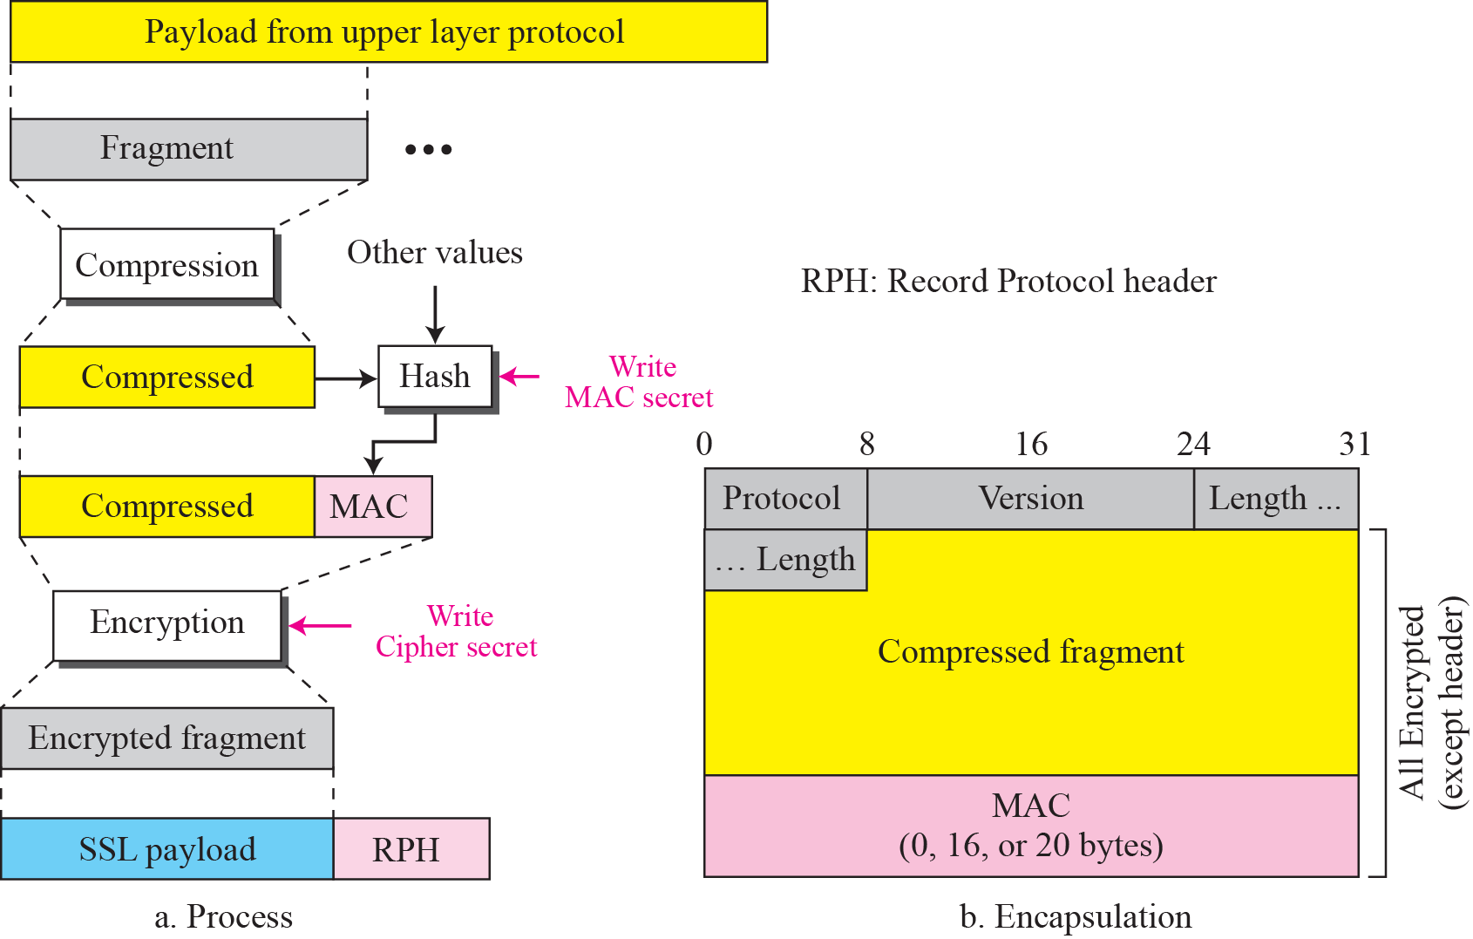
Processing done by the Record Protocol

Slide 62
Application Layer Security
There are two protocols providing security services for e-mails: Pretty Good Privacy (PGP) and Secure/Multipurpose Internet Mail Extension (S/MIME)
PGP :
PGP was invented to provide e-mail with privacy, integrity and authentication.
PGP can be used to create a secure email messages.

Slide 63
Scenarios
The scenarios to send the e-mail message can be with –
Plaintext Message
Authenticated Message
Compressed Message
Confidential Message

Slide 64
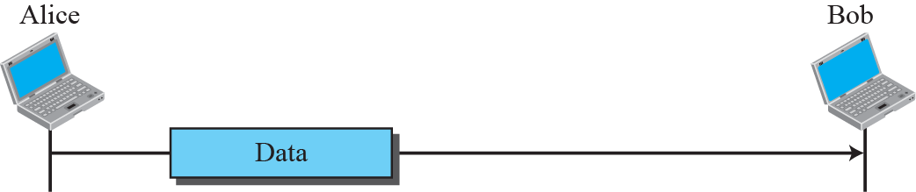
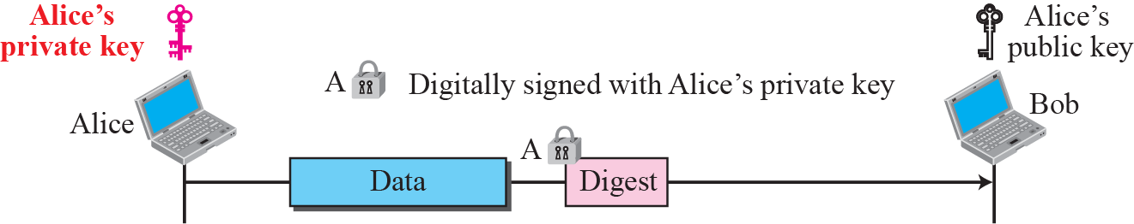
Scenarios

Slide 65
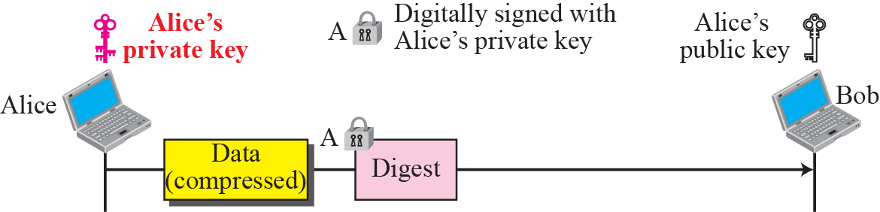
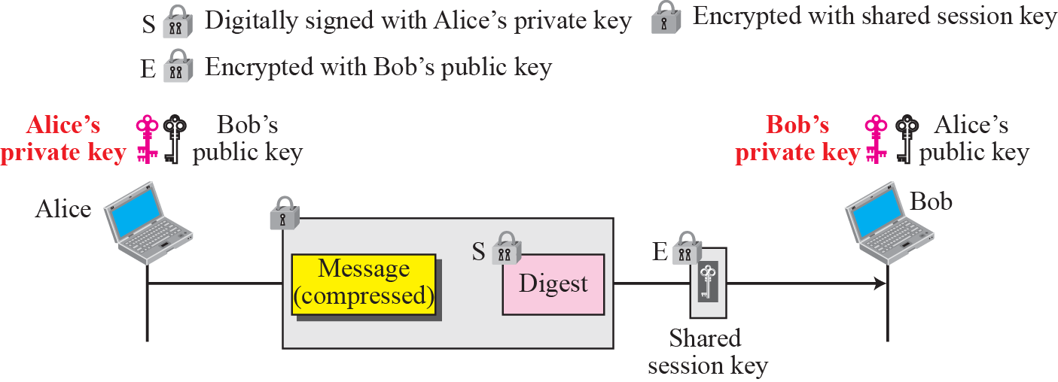

Slide 66
Code Conversion
Another service provided by PGP is code conversion.
Most email systems allow the message to consist of only ASCII characters.
To translate other characters not in the ASCII set, PGP uses Radix-64 conversion.

Slide 67
Segmentation
PGP allows segmentation of the message after it has been converted to Radix-64 to make each transmitted unit the uniform size allowed by the underlying e-mail protocol.

Slide 68

Key Rings
In all previous scenarios, we assumed that Alice needs to send a message only to Bob.
This isn’t the case always.
Alice may need to send to send message to many people; she needs Key rings.

Slide 69
Contd…
Two cases may arise :
Alice needs to send message to another person in the community.
She uses her private key to sign the digest.
She uses the receiver’s public key to encrypt a newly created session key.
She encrypts the message and signed digest with the session key created.

Slide 70
Contd…
Two cases may arise :
2. Alice receives a message from another person in the community.
She uses her private key to decrypt the session key.
She uses the session key to decrypt the message and digest.
She uses her public key to verify the digest.

Slide 71
PGP Certificates
PGP uses certificates to authenticate public keys.
In PGP, anyone in the ring can sign a certificate for anyone else in the ring.
There is no hierarchy of trust in PGP.
There can be multiple paths in the line of trust from a fully or partially trusted authority to a certificate.
The issuer of certificate is usually called as introducer.

Slide 72
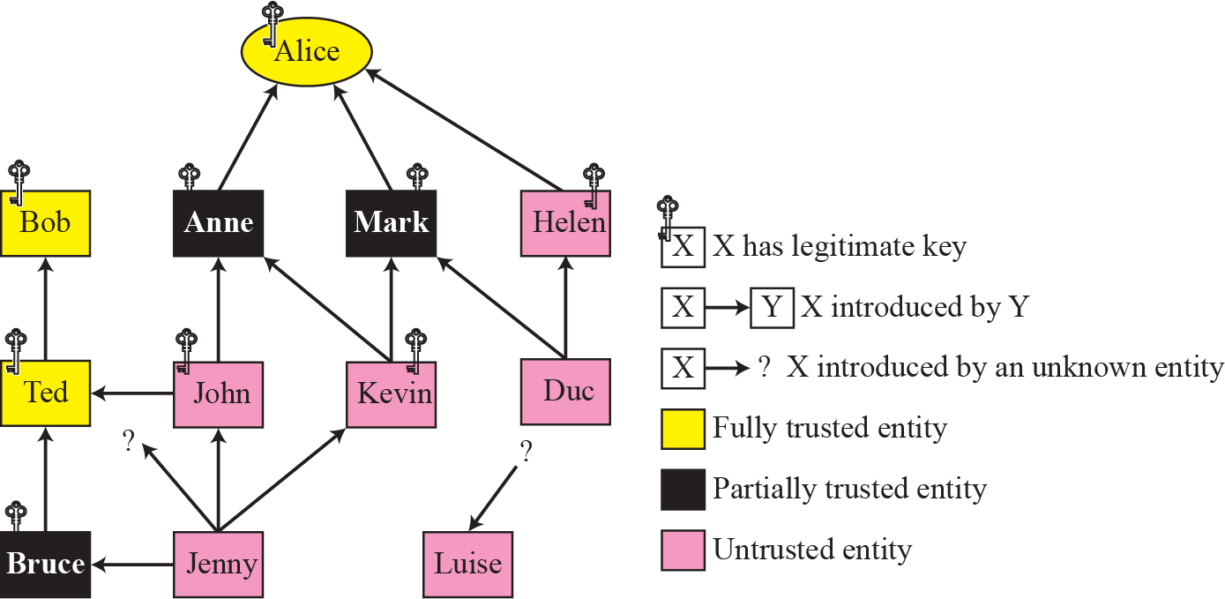
Trust Model

Slide 73
S/MIME
S/MIME is another security service designed for electronic mail.
To define how security services such as confidentiality or integrity can be added to MIME content types S/MIME has defined Cryptographic Message Syntax (CMS).
CMS :
The syntax in each case defines exact encoding scheme for each content type

Slide 74
Data Content Type
Signed Data Content Type : Provides only integrity of data.
It contains any type and zero or more signature values.
The encoded result is an object called signed data.

Slide 75
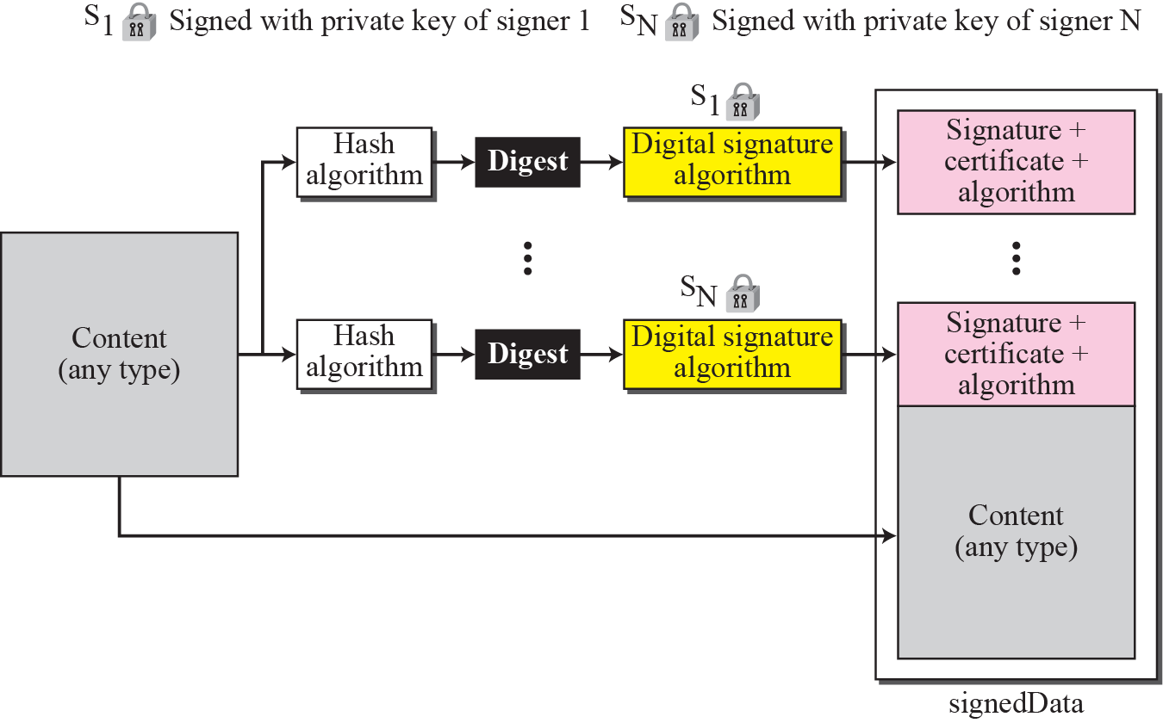
Signed Data Content Type

Slide 76
Data Content Type
Enveloped Data Content Type : Provides privacy for the message.
It contains any type and zero or more encrypted keys and certificates.
The encoded result is an object called enveloped data.

Slide 77
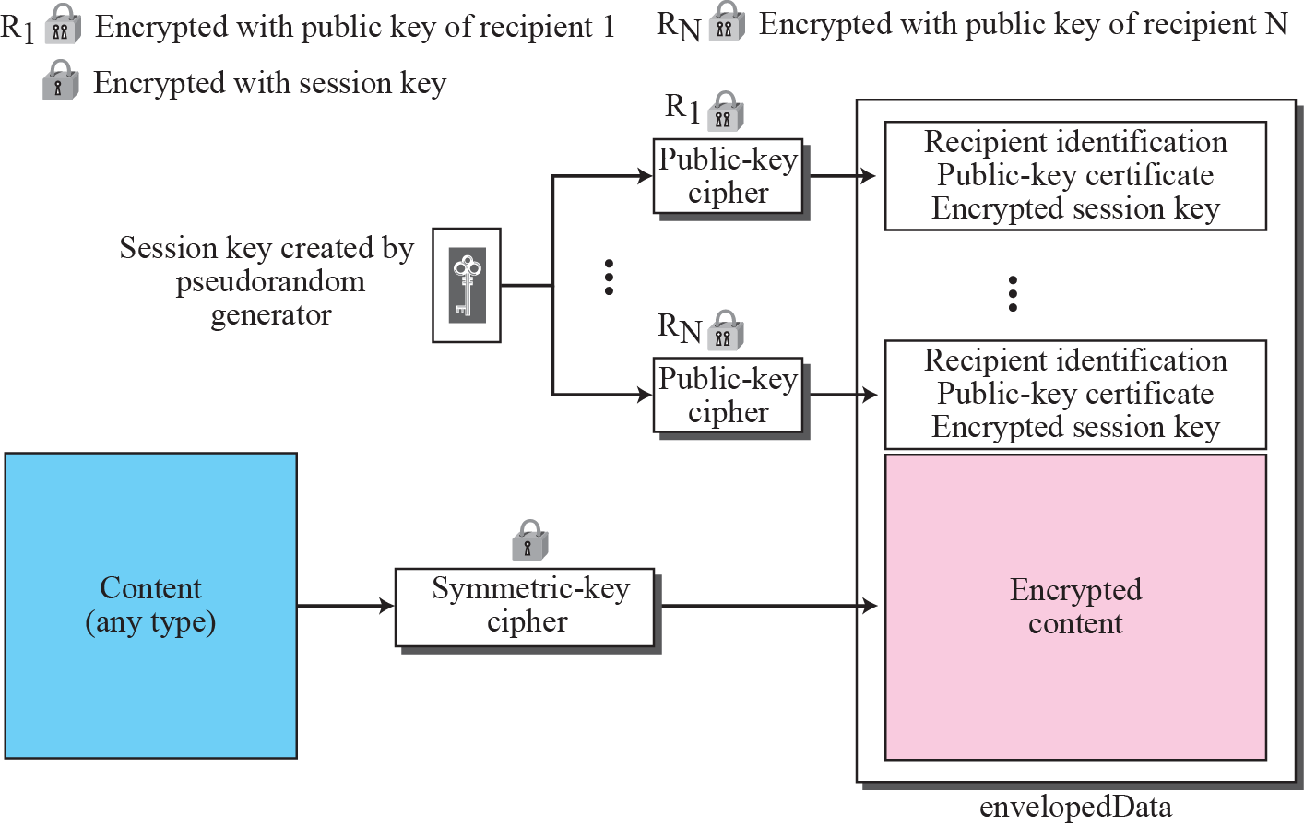
Enveloped data content type

Slide 78
Data Content Type
Digested Data Content Type : Provides integrity for the message.
The result is normally used as the content for the enveloped data content type.
The encoded result is an object called digested data.

Slide 79
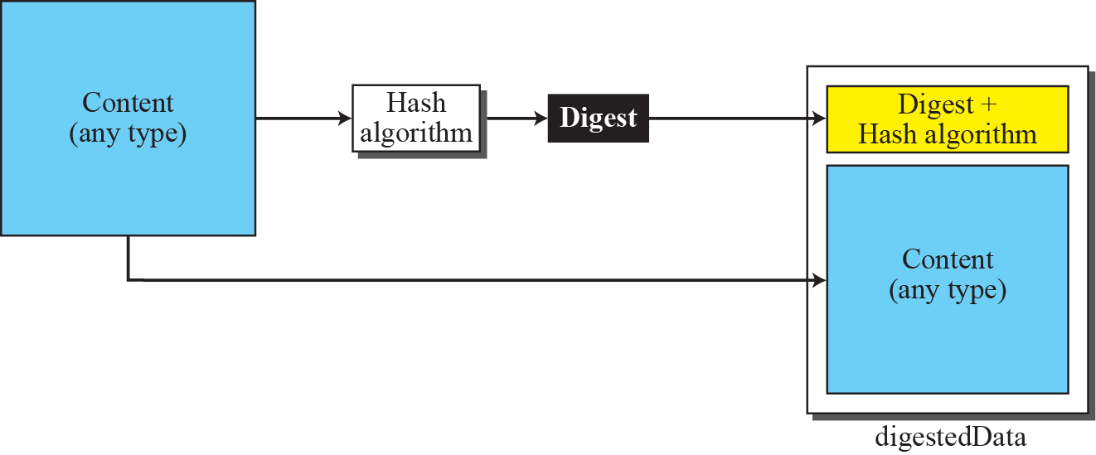
Digested Data Content Type

Slide 80
Data Content Type
Encrypted Data Content Type : This type is used to create an encrypted version of any content type.
It can be used to store the encrypted data instead of transmitting it.
The user employs any key and any algorithm to encrypt the content.
The encrypted content is stored without including the key or the algorithm.
The object created is called encrypted data.

Slide 81
Data Content Type
Authenticated Data Content Type : This type is used to provide authentication of the data.
The object is called authenticated data.

Slide 82
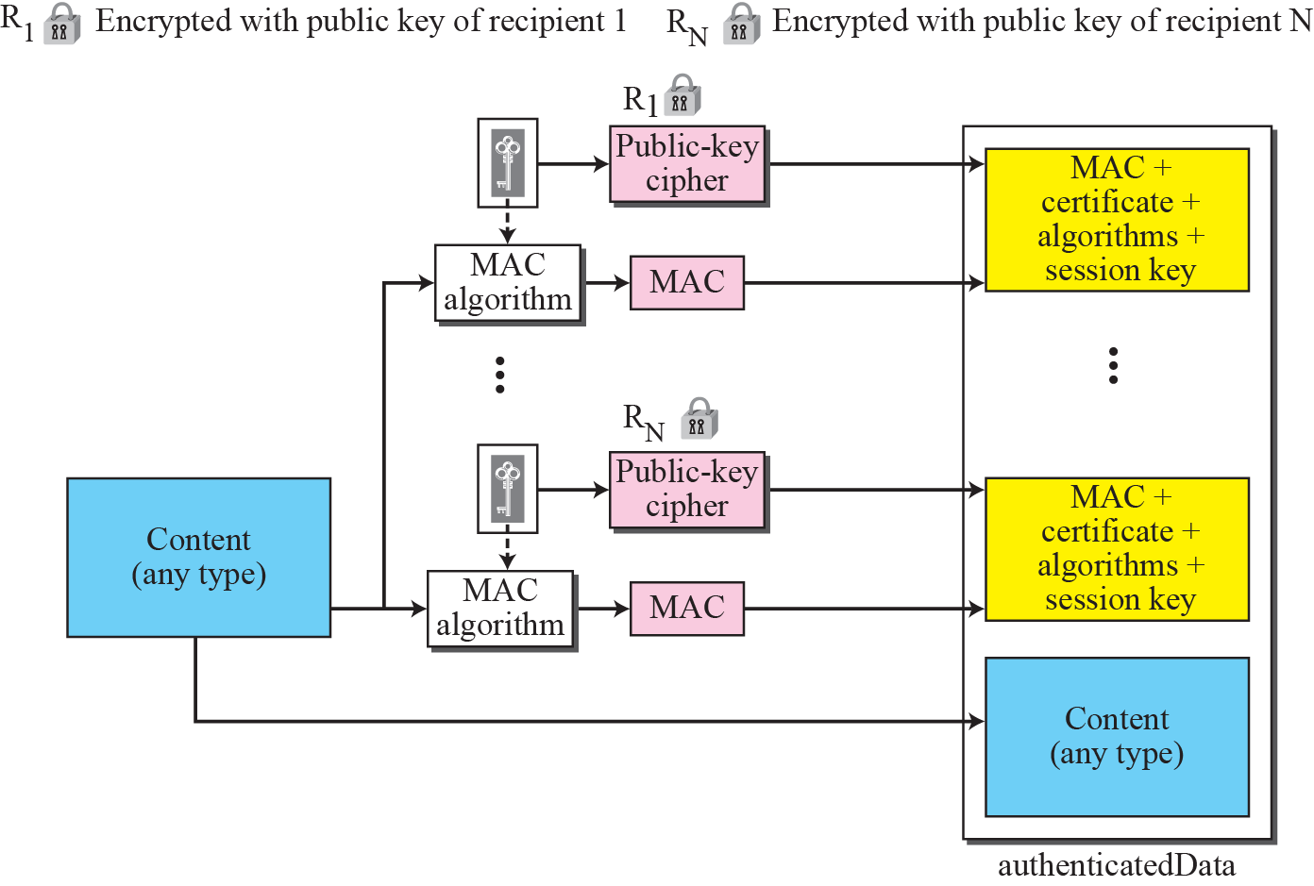
Authenticated data content type

Slide 83
Process
MAC key is generated for each recipient using pseudorandom generator.
The MAC key is encrypted with the public key of the recipient.
MAC is created for the content.
The content, MAC, algorithms and other information is collected together to form the authenticated data object.

Slide 84
Key Management
Key management in S/MIME is a combination of key management used by X.509 and PGP.
S/MIME uses public key certificates signed by the certificate authorities defined by X.509.
However, the user is responsible to maintain the web of trust to verify signatures as defined by PGP.

Slide 85
Firewall
All previous security measures cannot prevent intruder from sending a harmful message to a system.
To control access to a system we need firewalls.
A firewall is a device installed between the internal network of an organization and rest of the Internet.

Slide 86
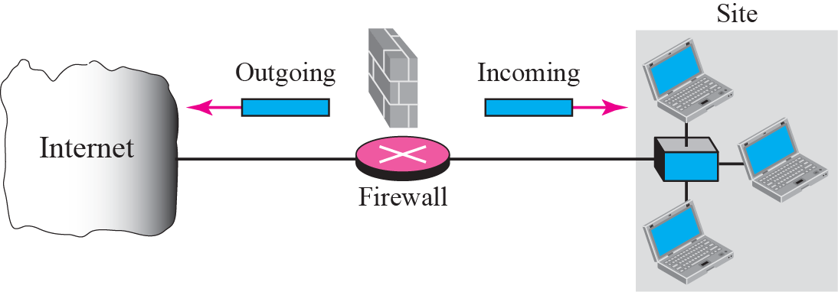
Firewall

Slide 87
Firewall
Firewall may filter all incoming packets destined for a specific host or a specific server such as HTTP.
It can be used to deny access to a specific host or a specific service in the organization.
A firewall is usually classified as a packet filter firewall or a proxy based firewall.

Slide 88
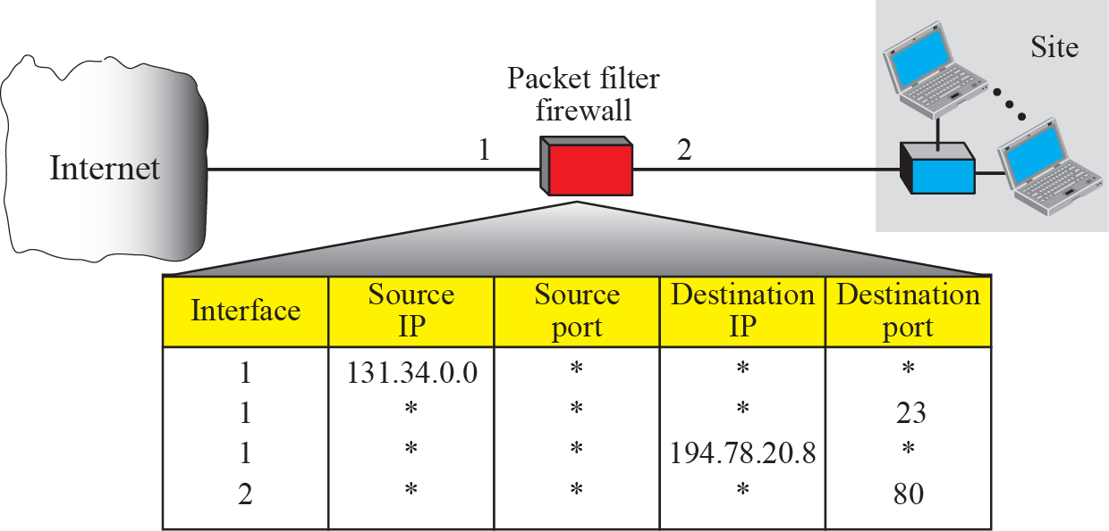
Packet Filter Firewall
A Firewall can be used as a packet filter.
It can forward or block packets based on the information in the network and transport layer headers.
It is a router that uses a filtering table to decide which packets must be discarded.

Slide 89
Contd…
According to the figure, the following packets are filtered:
Incoming packets from network 131.34.0.0 are blocked (security precaution). * means any.
Incoming packets destined for any internal TELNET server (port 23) are blocked.
Incoming packets destined for internal host 194.78.20.8 are blocked.
Outgoing packets destined for HTTP server (port 80) are blocked.

Slide 90
Proxy Firewall
The packet filter firewall is based on the information available in the network layer and transport layer headers (IP and TCP/UDP).
However, sometimes we need to filter a message based on the information available in the message itself.
Assume that an organization wants to implement the following policies regarding its web pages :

Slide 91
Proxy Firewall
Only those Internet users who have previously established business relations with company can have access; access to other users must be blocked.
In this case a packet filter firewall is not feasible because it cannot distinguish between different packets arriving at TCP port 80 (HTTP).
One solution is to install a proxy computer which stands between customer computer and corporation computer.

Slide 92
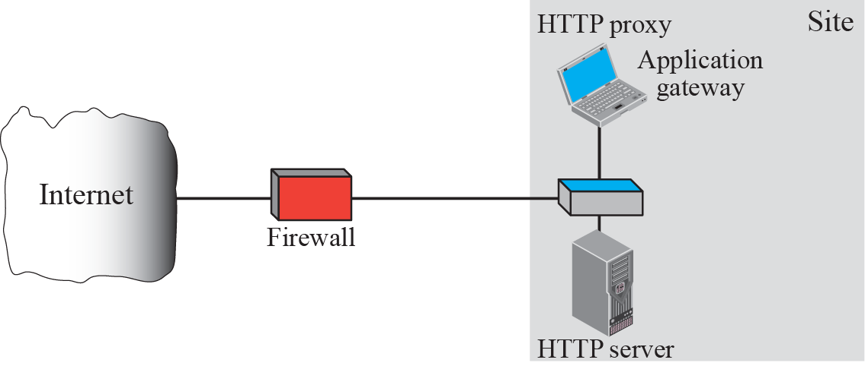

Slide 93
Intrusion Detection System (IDS)
Network security can be fairly easily compared to physical security—the more you wish to protect something and restrict access to it, the more security you need.
In the network and data security areas you have protective layers in the form of passwords, firewalls, access lists, file permissions, and intrusion detection systems.
Most organizations have their own approach to network security, choosing the “layers” that make sense for them after they weigh risks, potential for loss, cost, and manpower requirements.
A well-secured system is one with up-to-date application and operating system patches, well-chosen passwords, the minimum number of services running, and restricted access to available services.

Slide 94
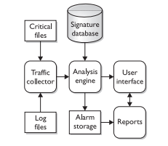
Intrusion Detection System (IDS) Types
Host Based IDS :A host-based IDS (HIDS) is a system that examines log files, audit trails, and network traffic coming in to or leaving a specific host.
Host-based IDSs can operate in real time, looking for activity as it occurs, or batch mode, looking for activity on a periodic basis.

Slide 95
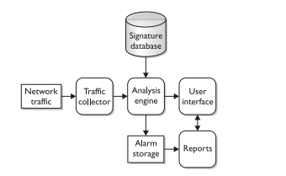
Intrusion Detection System (IDS)
Network Based IDS:A network-based IDS, as the name suggests, focuses on network traffic—the bits and bytes traveling along the cables and wires that interconnect the systems.
A network IDS (NIDS) must examine the network traffic as it passes by and be able to analyze traffic according to protocol, type, amount, source, destination, content, traffic already seen, etc. This analysis must happen quickly, and the IDS must be able to handle traffic at whatever speed the network operates on to be effective.

